Slide 2
Benefits of frameworks:
Efficiency
Security
Cost

Slide 3

Bad cake bad code

Slide 4

More bad cake

Slide 5

Framework template

Slide 6

Good cake good code

Slide 7
A 2018 survey carried out by DZone shows that the three most commonly used JavaScript frameworks are:
React
Angular
Vue

Slide 8
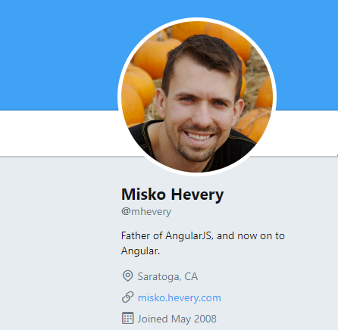
Creation of AngularJS

Slide 9
Hevery proclaimed that the goal of AngularJS was to:
“Eliminate the guesswork in creating web app structure and take the pain and the boilerplate out of web client apps” (median.com, 2017).

Slide 10
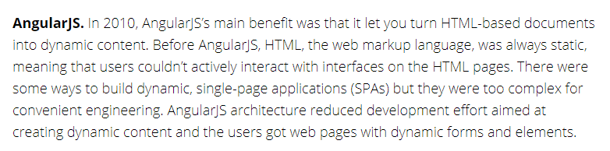
Angularjs role

Slide 11
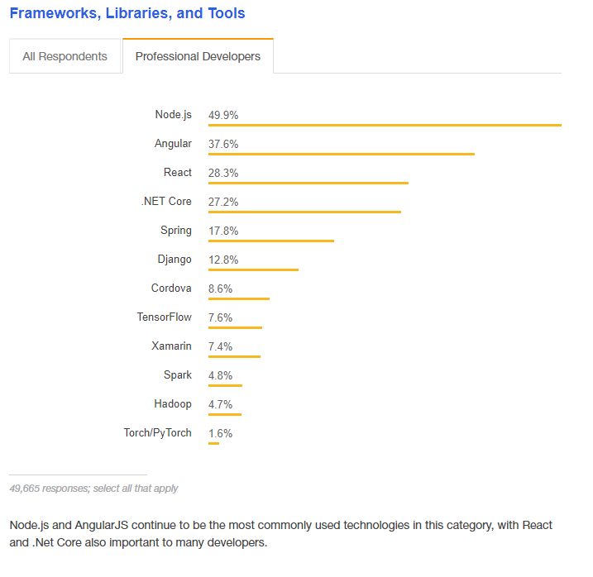
Angularjs popularity

Slide 12
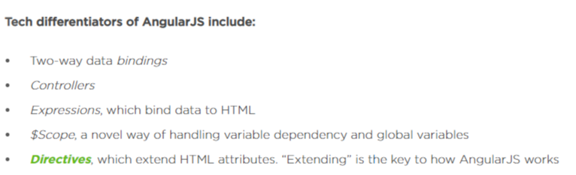
Angularjs features

Slide 13
Pros of angularjs
Owned by Google meaning the high standard of quality is always maintained.
Developers can be more efficient by using less code
Runs on all major browsers and mobile platforms
Part of the MEAN stack (along with MongoDB, ExpressJS, and Node.js) making it possible to code from front end to back end in just JavaScript
Two-way data binding means users view changes in real time giving a far more interactive experience

Slide 14
Cons of angularjs
Angular isn’t backwards compatible, meaning after 2021 AngularJS will be phased out
Apps which rely on constant DOM manipulation such as video games can tend to lag
Lack of flexibility compared to rivals, React, and Vue due to rigidly working only within the Angular framework

Slide 15
Companies who use angularjs
NBC
Nike
Dell
Intel
ABC
Amazon
Wal-Mart
YouTube
American Express
Google
Marriott
Virgin America

Slide 16

Angularjs sample

Slide 17

Thank you for listening

